Slide 1

StudyRoom
Done by:
Ibrahim rzaiqat
Ahmed Osman Afey

Slide 2
Project Overview
StudyRoom is an innovative platform designed to facilitate collaborative learning among students. It allows users to join or create virtual study rooms tailored to specific languages, subjects, chapters, and lessons. The app fosters interaction, knowledge sharing, and efficient studying through many communication features and structured group discussions.
By developing this new advanced study method our aim is to provide the most seamless education application and platform for not only interaction but for also sharing useful resources to other students to have an strong development skills for the diverse users.

Slide 3
Problem Statement
Some students may lack important tools for collaborative research and studying
May find it hard to other partners with the same skill level as them
Performance issues in some existing platforms or may be too expensive for people that can’t afford
Teachers may it in very hard to switch from multiple platforms when they are managing the class
Barriers to achieving academic and specific professional goals

Slide 4
Solution Approach
Making different severs Open and private servers:
For different languages , subjects and lesson based of there specific interest.
Finding people who have the same skill level as them.
Interactive Tools:
Screen sharing
Chat box for those who don’t want to speak.
Built in white board for those who understand to explain by showing examples and diagrams.

Slide 5
Visual Infographics
User Personas
Ahmed Jaafar(High school Student);
His goals are to improve his programming skills
His main problem is that he lacks in finding programming partners.
Emma Shisiu(College Student);
Her goals is to the practice technical English.
Her main problem Is that she is finding it really hard to find peers for intellectual debate.
Jacob Willams(College Professor);
His goals are to have a smooth communication with students.
His main problem is that doesn’t want to switch in-between multiple platforms.

Slide 6
Infographics Idea
We can show a flow diagram showcasing the apps workflow;
User Login → Server Selection → Interactive Session.
Also charts like pie or bar charts are good to show the user goals and things that need to work on.

Slide 7
Development Journey
AGILE METHODOLOGY;
Sprints- tasks are broken down into 1-2 week sprints
Stand up meeting- Regular meeting in real life to discuss and update each other to ensure our progress and work are aligned.
TECH STACK
Frontend- Javascript, HTML/CSS
TypeScript;
Backend- python or Node.js
Database- MongoDB (NoSQL)
Authentication- JWT for secure session management.

Slide 8
Features Demonstration
Core Functionalities;
Create and enter severs due to your own preferences.
Use tools where you can interreact with for collaborative learning
Managing sessions much more efficient with much more advanced controls for the teacher/educator.
Non-Functional Strengths;
Very rapid response time from the server
Amazing with the users personal information and secure data.

Slide 9
Lessons Learned
KEY INSIGHTS;
User centered design for the uses for there specific needs.
Harmonizing scalability and proformance in the development process.
Effective use of Agile for different practices for organized progress.
CHALLENGES OVERCOME;
Usage of supporting multi-languages for support
Giving a map for ensuring our non-technical users an intuitive navigation.

Slide 10
Future Improvements
Planned Improvements:
AI power features
Language Translate system For people who don’t speak English
Programmed assistance
Advanced Analytics:
Progess tracked and provide recommendation for our users
Mobile App Development:
Dedicate our next project to create an app for iOS and Android so people can have an increased accessibility

Slide 11
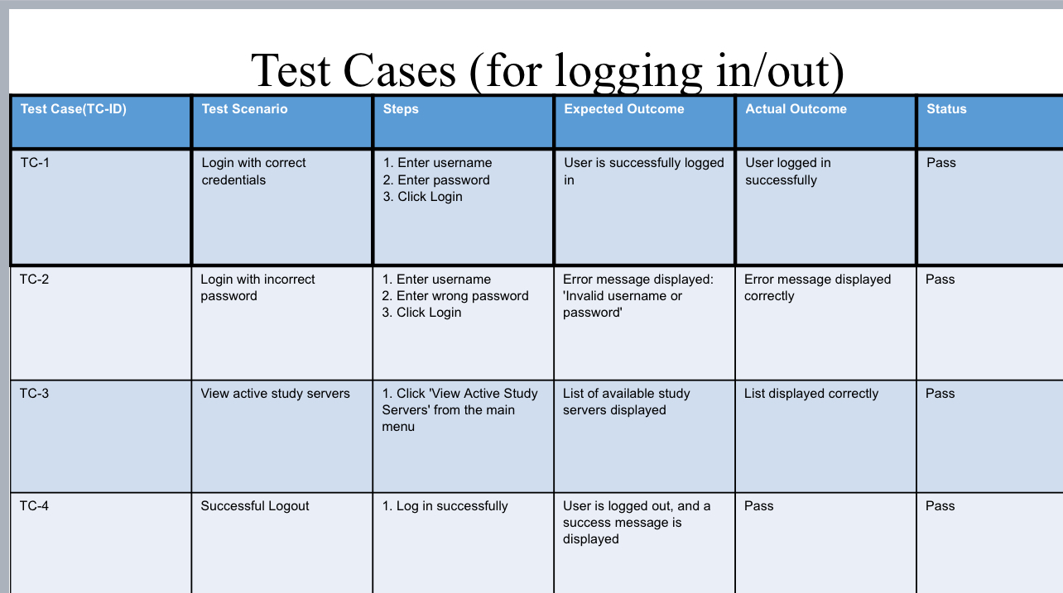
Test Case For Logging In

Slide 12
THANK YOU FROM OUR TEAM<3
“Programs must be written for people to read, and only incidentally for machines to execute.”
– Harold Abelson

